Slide 1
A rudimentary Unicode Abstraction
Attempting to wrangle encoding and more
ThePhD – March 3rd, 2018
@thephantomderp
C++ Text Working Group, #std-text-wg for Cpplang Slack

Slide 2
Why?
std::wstring_convert is sort of terrible
thankfully has been deprecated
Needed to not sprinkle to_utfX or to_string<utfX> all over API boundaries
leaves internal format a mystery until you look at boundary code / docs
std::string / std::wstring poor descriptors
std::u16string is a name, but it enforces and helps with nothing

Slide 3
So another string class?
Two of them, actually
text_view -> basic_text_view<Char, Encoding, ErrorPolicy>
text -> basic_text<Storage, Encoding, ErrorPolicy>

Slide 4
The Times
Clang (3.3/3.4) and GCC (4.9, 5.x)
the cool toys I used to do things and then prepared for Stage II: Reality
Sanity’s Eclipse, 2013
Also known as Visual Studio
November CTP, ICEs on the daily “Hey this compiles in GCC surely it- oh…”
C++11, barely scratching 14
“C++07”, with VC++

Slide 5
basic_text_view, version I
Codepoint abstraction, using template parameters:
Char (= char) – pick code unit denomination
Encoding (= default_encoding_t<Char>) – controlled what underlying contiguous sequence would be treated as
Encoding.decode( Iter, Iter ), Encoding.encode( Iter, Iter ) [+ reverse]
ErrorPolicy (= detail::default_error_policy) – controlled how encoding errors would be handled
Policy( Encoding&, encoded/decoded_result, Iter, Iter ) – do whatever

Slide 6
Not… Quite!
Since we pass Char template, assumes unit of storage is const char*
Contiguous storage got us 90% of the way there, though
Honestly good enough™
Nevertheless, modify interface anyways for completeness’s sake
basic_string_view<Char> handled viewing a basic string
Side note: handled mutability / immutability for us, but std:: is different
const Char = immutable | Char = mutable

Slide 7
basic_text_view, version 2
basic_text_view<Rangeable, Encoding, ErrorPolicy>
“look at us we’re cool with ranges!”
boiled down to “listen just get the begin/end and shovel it through algos”
could never touch range-v3 with 10 ft. pole on Visual Studio
Wrote encoding_/decoding_iterator<BaseIt, Encoding, ErrorPolicy>
Handled all immutable algorithms, offered codepoint interface
find/rfind, starts_with, ends_with, search, compare, etc…

Slide 8
Basic_text
basic_text<Storage, Encoding, ErrorPolicy>
Similar to last, except template parameter Storage – just what we are storing
struct basic_text : basic_text_view<Storage, Encoding, ErrorPolicy>
No duplication, all member functions get carted over, it’s all so nice
basic_text_view handles the storage for free
insert, erase, append, prepend, replace, to_upper/lower/title

Slide 9
Converting Constructors I
using text = basic_text<std::string>; // std::string is assumed to be utf8
text bark(u“🐶”); // assumes utf16, default_policy
text wine(U“🍷”); // assumes utf32, default_policy
text wine2(u8“🍷”); // assumes utf8, default_policy
text for_char_literals(“abcd”); // assumes utf8, default_policy
text my_text(U“🍷”); // assumes utf32, default_policy
basic_text<std::string, ascii> ascii_text(u“🔥”); // static_assert triggers
basic_text<std::string, ascii> ascii_text(u“☢️”, utf16{}, my_policy{}); // ok…

Slide 10
Converting Constructors II
Not sure if best implementation, truly
converting constructors can be expensive, not sure I’d want to standardize
or if I’d want to do it again, really
But catching the errors with static_asserts and similar was nice!
Having constructors similar to std::string was useful for codebase integration
Most understood converting constructors cost, easily used string/text_view when performance mattered

Slide 11
Implementation Details
Also had “allowed upgrades”
e.g. example ascii -> utf8 did not trigger a static assert
☢️ BAD: also was optimized to just memcpy bits! ☢️
☢️ Did not require a policy that allowed for such: could be invalid ASCII ☢️
comparisons used codepoints, optimizations ✔️ encoding/storage equivalent
applied this internally to everything, since replace/append/prepend could take arbitrary ranges with optional policy/char-range

Slide 12
⚠️ Problematic ⚠️
“Ў” != “Ў”
??? What?
Welcome to the Combining Codepoint Fair!
Cyrillic у combined with breve (˘): Ў = 2 codepoints
Visually identical and canonically equivalent, but Short U (Cryllic): Ў = 1 codepoint
Reversing a string does not split up code units, but combined codepoints split

Slide 13
Prepare for Future
Time to look into Normalization and Segmentation…
Normalization and Segmentation can be done as iterators alone?
Locales needed for graphemes / extended grapheme clusters, not normalization
Prepared UCD (Homerolled)
Release-mode 8.5~8.8 megabytes, definitely not best compression
after beating it up to get around string limits / initializer_list limits in Visual Studio
Included most everything, even Han data

Slide 14

Time for Normaliza-
And then life happened.
Was going to pick Normalization Form Compatibility Decomposition + Canonical Composition, NFKC
Stable Code Points property mentioned in UAX #15 §9
Best for comparing with the outside world, not the best for internal processing?
3 or so years later, I enter a Slack Workspace, and there’s this channel named…

Slide 15
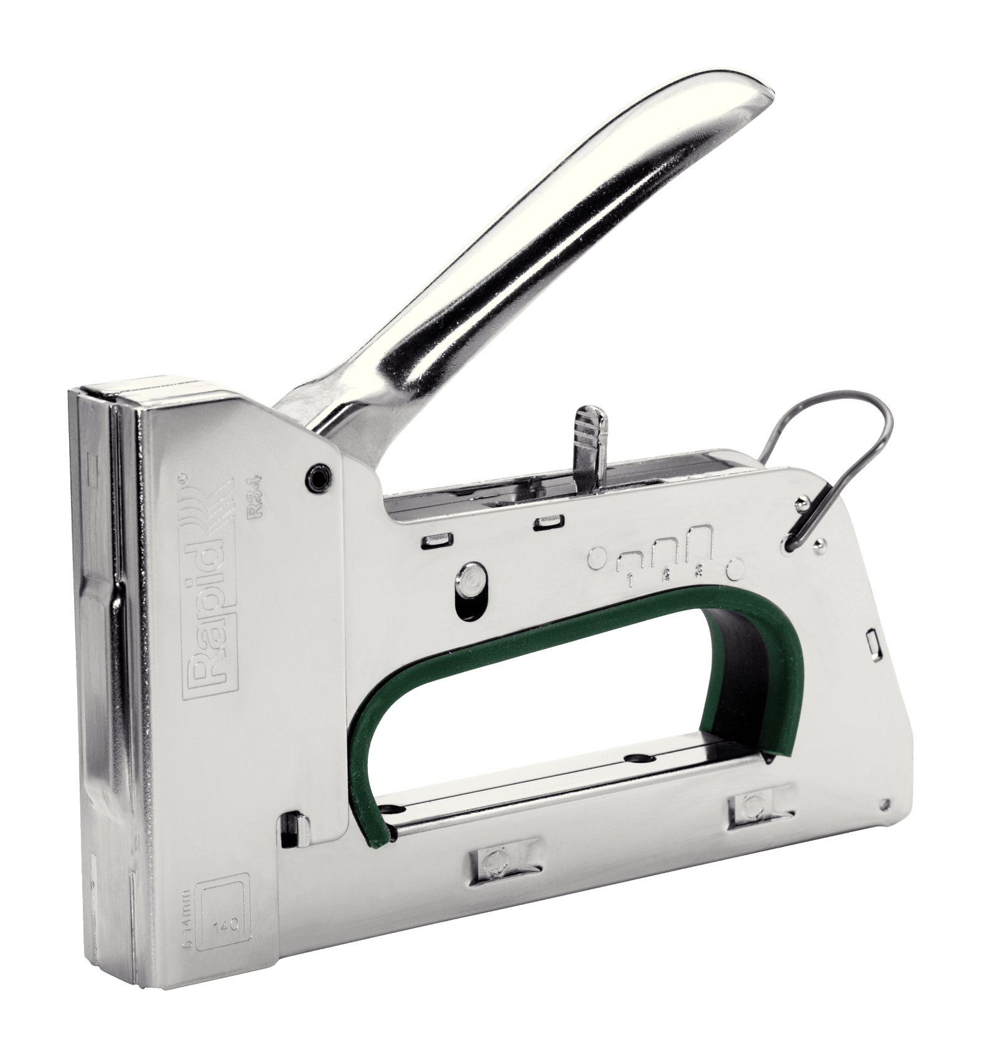

What To Do: A Conversation
ThePhD: So tzlaine/text it’s like Tom’s text_view, but stapled to utf8?
tzlaine: Yes. With quite a few staples.

Slide 16

What To Do
De-couple the text class (and the rope class, too!) from its utf8 storage mechanism
Split asunder:
into a text_view alike class similar to what Tom Honermann’s is
into text class alike to what I used to have (except way better)
hammer out free functions and their interfaces (transcoding, etc.)
Enjoy the beautiful new C++17/20 in Visual Studio save ICE for hot days 😎

Slide 17
Time Split
1st Priority: figure out how to interact with the committee
Do this with less-important std::embed( … ) proposal (unrelated)
Work on de-stapling tzlaine/text from its utf8 representation
Look at piling more UCD data into a complete database for C++ consumption
Perhaps standardized way to query such data? (Maybe as an extension?)

